Slide 1
Ch. 4 Inventory from Kimball and Ross
IDS 521

Slide 2
Key concepts in this chapter
Representing organizational value chains
Semi-additive facts
Transactions, periodic snapshots and accumulating snapshots
Bus architecture and bus matrix
Opportunity/stakeholder matrix
Conformed dimensions and facts
Data governance

Slide 3
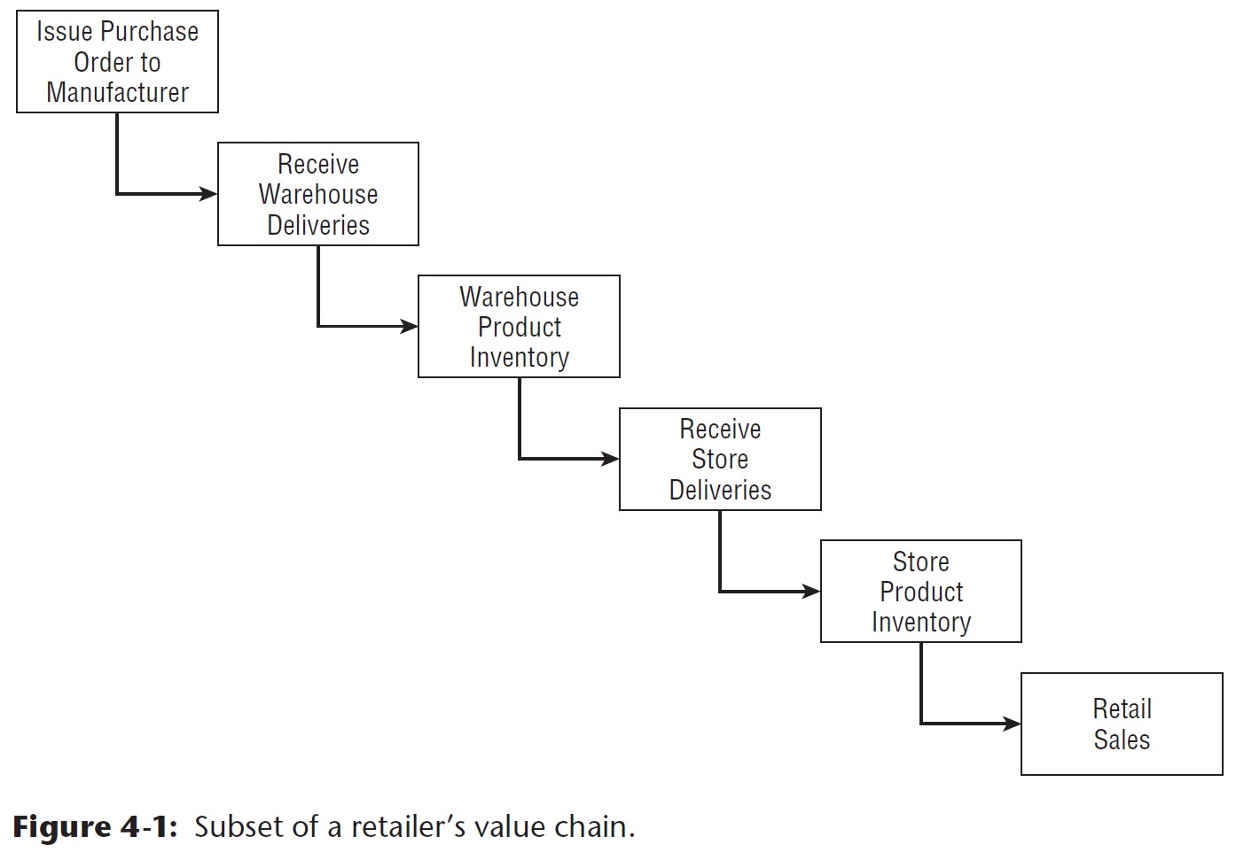
Organizational value chains

Slide 4
Organizational value chains
Operational source systems produce transactions or snapshots at each step
Most DW/BI systems aim to monitor performance
Each process produces unique metrics, at unique time intervals, with unique granularity and dimensionality:
One or more fact tables for each process

Slide 5
Inventory Models
Transactions
Periodic snapshots
Accumulating snapshots

Slide 6
Transactions model

Slide 7
Transactions list
Receive product
Place product into inspection hold
Release product from inspection hold
Return product to vendor due to inspection failure
Place product in bin/ pick from bin
Package product for shipment
Ship to consumer
etc…

Slide 8
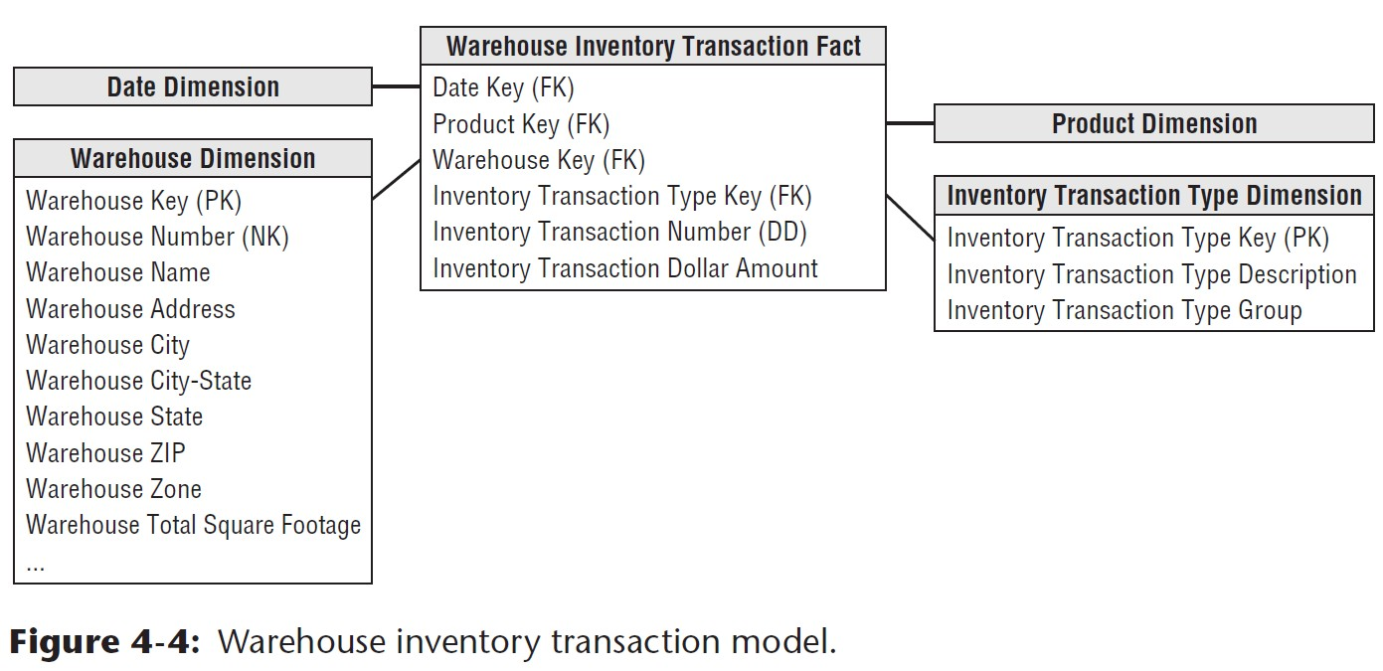
Warehouse inventory transaction model

Slide 9
Transaction model: Pros and Cons
Pros:
Measures frequency and timing of specific transaction types
More granular (detailed) than inventory snapshot models
Cons:
Cumbersome and impractical for broad analysis across: dates, products, warehouses, or vendors.
Hard to get a cumulative view of a process.

Slide 10
Inventory Periodic Snapshot

Slide 11
Inventory Periodic Snapshot
Periodic (e.g. daily) snapshots of inventory
Example: Daily inventory of each product in each store.
Most common inventory schema.
Good choice for long-running, continuously replenished inventory scenarios.

Slide 12
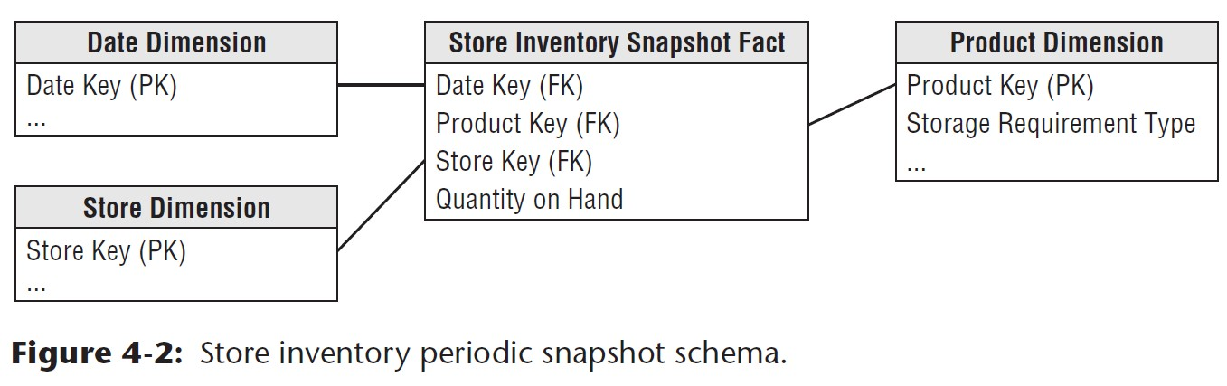
Schema: Store inventory periodic snapshot

Slide 13
Semi-additive facts
All measures that record a static level are inherently non-additive across the date dimension
inventory levels
financial account balances
intensity measures: e.g. room temperature
Aggregate by averaging over the number of time periods (not just the number of rows)
OLAP products allow you to define aggregation rules

Slide 14
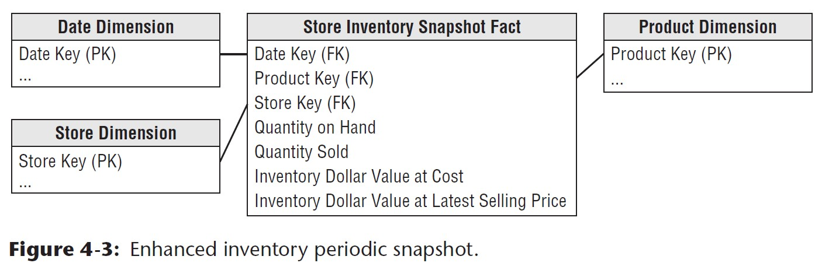
Enhanced inventory periodic snapshot
Notice the fully additive measures: Quantity Sold, Inventory Dollar Value at Cost (of sold items), Inventory Dollar Value at Latest Selling Price

Slide 15
Inventory Accumulating Snapshot

Slide 16
Accumulating snapshot
Used for processes that have definite stages: clear beginning, end, and milestones that can be identified in between
Shows the elapsed time between milestones of a workflow or pipeline.
Need to reliably distinguish products received in one shipment from those received at a later time: e.g. a product serial number or lot number

Slide 17
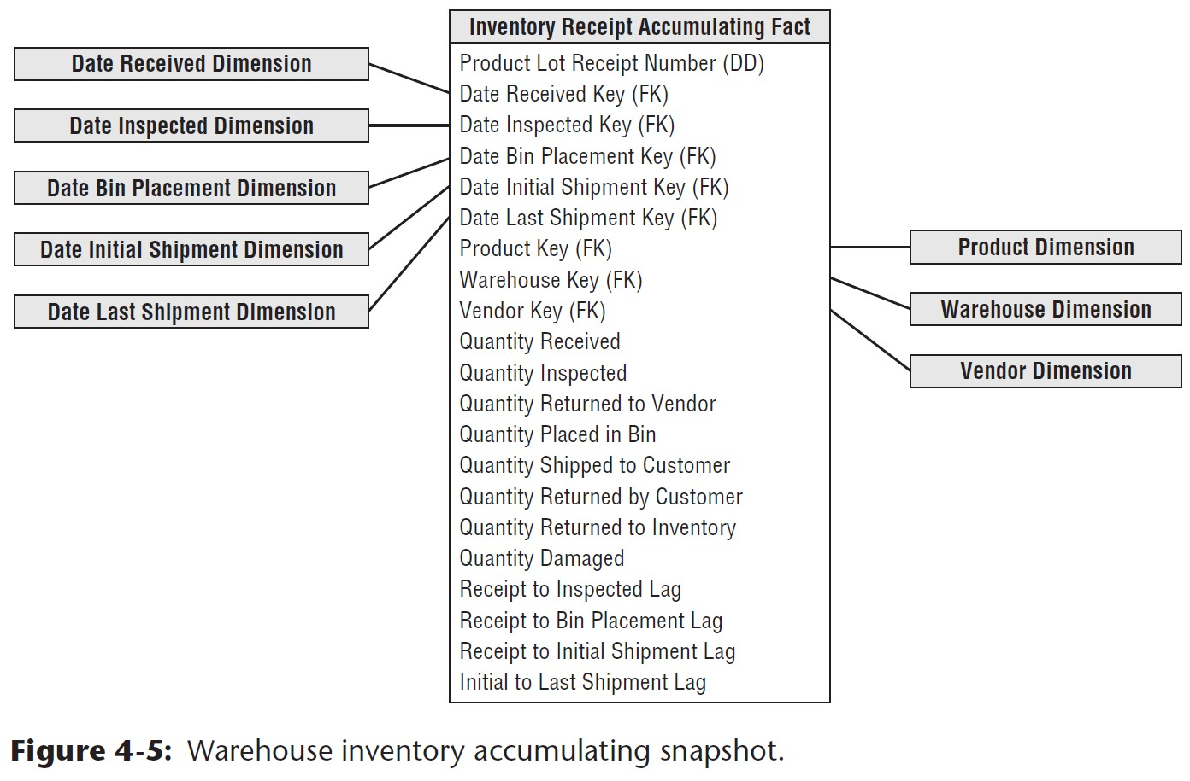
Accumulating snapshot model

Slide 18
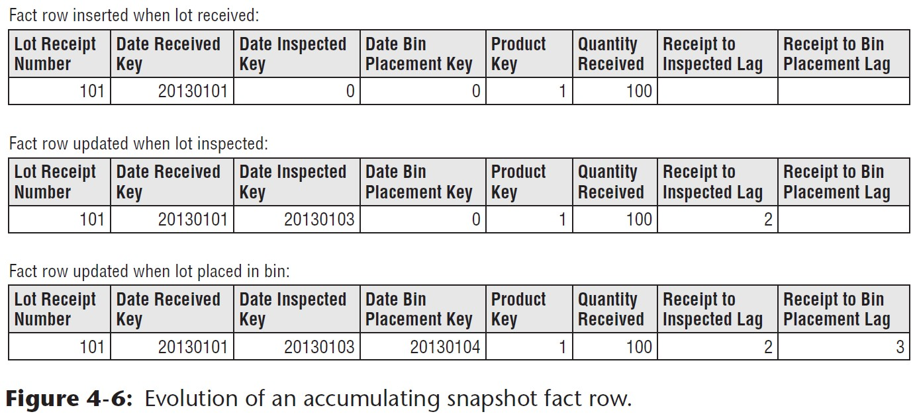
Inventory accumulating snapshot

Slide 19
Accumulating snapshot
At each stage in a process, revisit the rows to update them.
Updates force both facts and dimension foreign keys to change
OLAP cubes need to be reprocessed with each update – this is problematic.

Slide 20
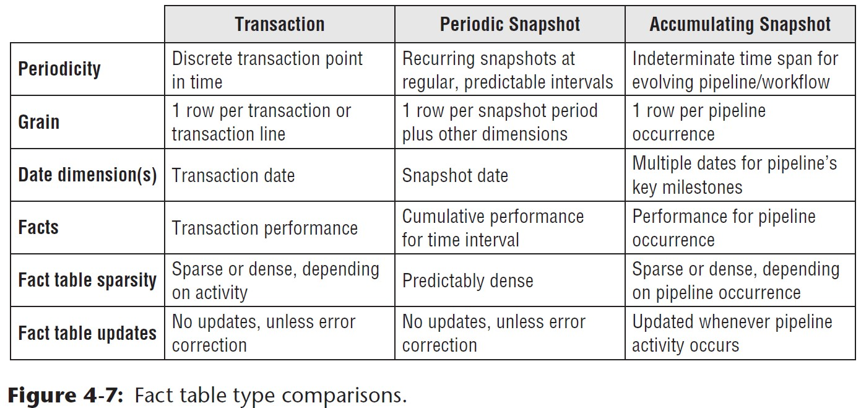
Fact table comparisons

Slide 21
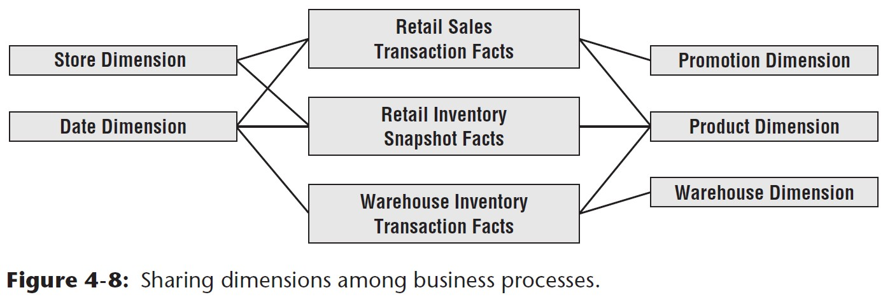
Value chain integration

Slide 22
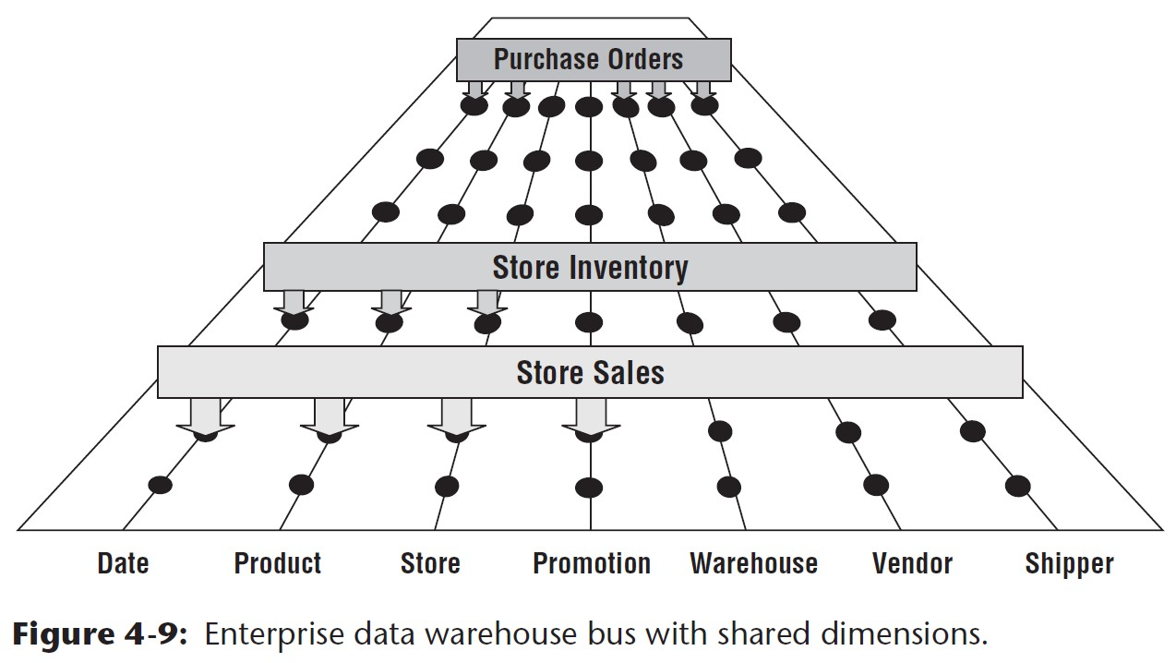
Enterprise Bus Architecture

Slide 23
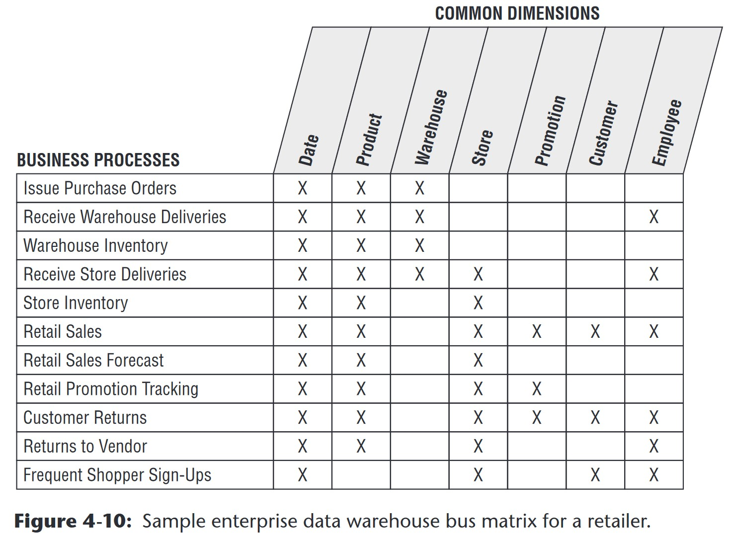
Enterprise bus matrix

Slide 24
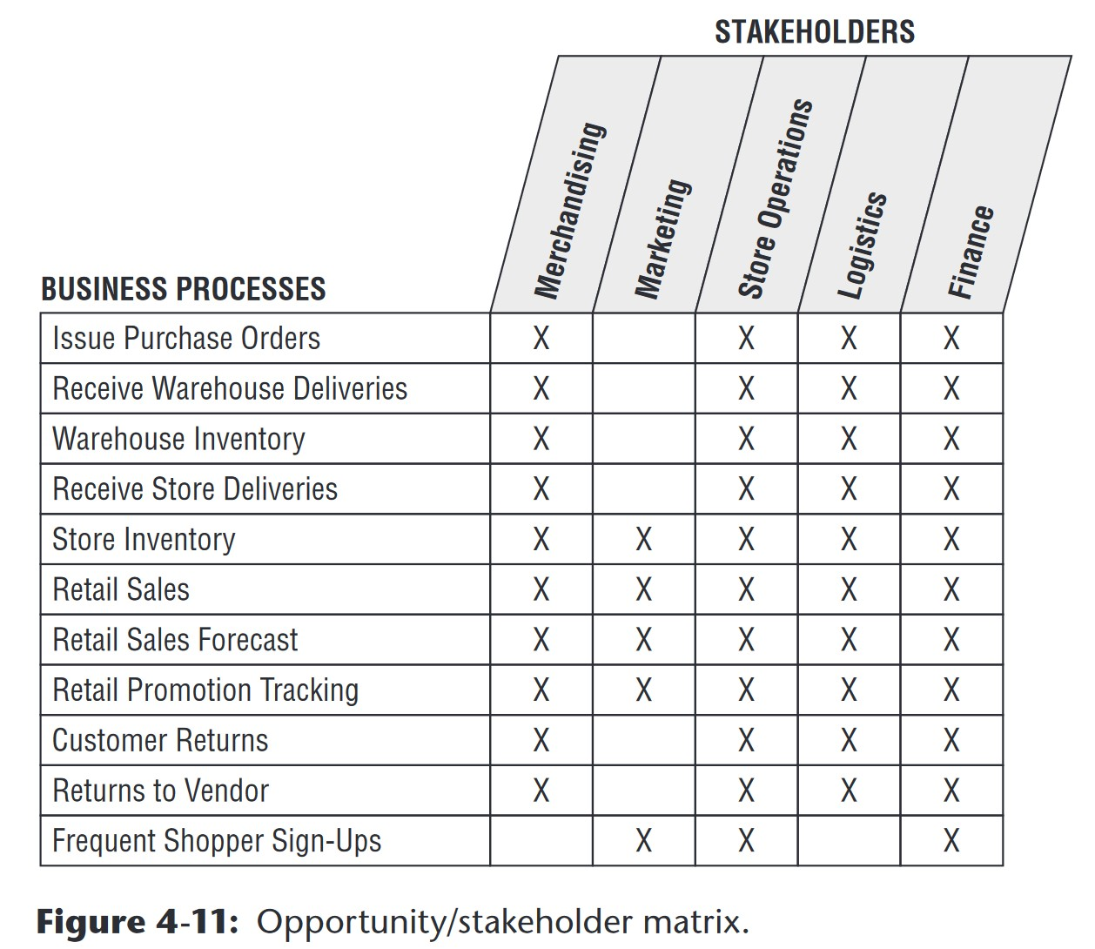
Opportunity/stakeholder matrix

Slide 25
Common bus matrix mistakes
Departmental or overly encompassing rows
Report-centric or too narrowly defined rows
Overly generalized columns
Separate columns for each level of a hierarchy

Slide 26
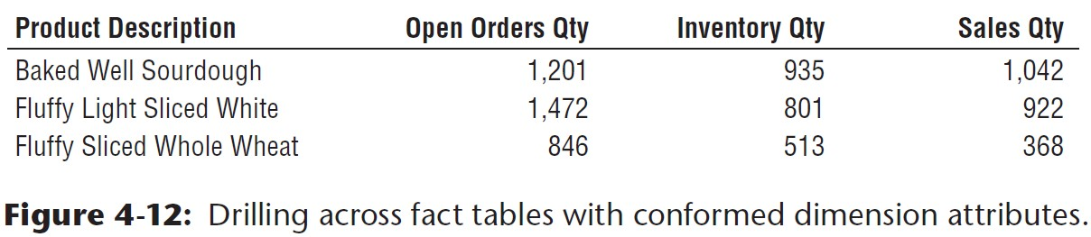
Drilling across fact tables with conformed dimension attributes

Slide 27
Identical conformed dimensions

Slide 28
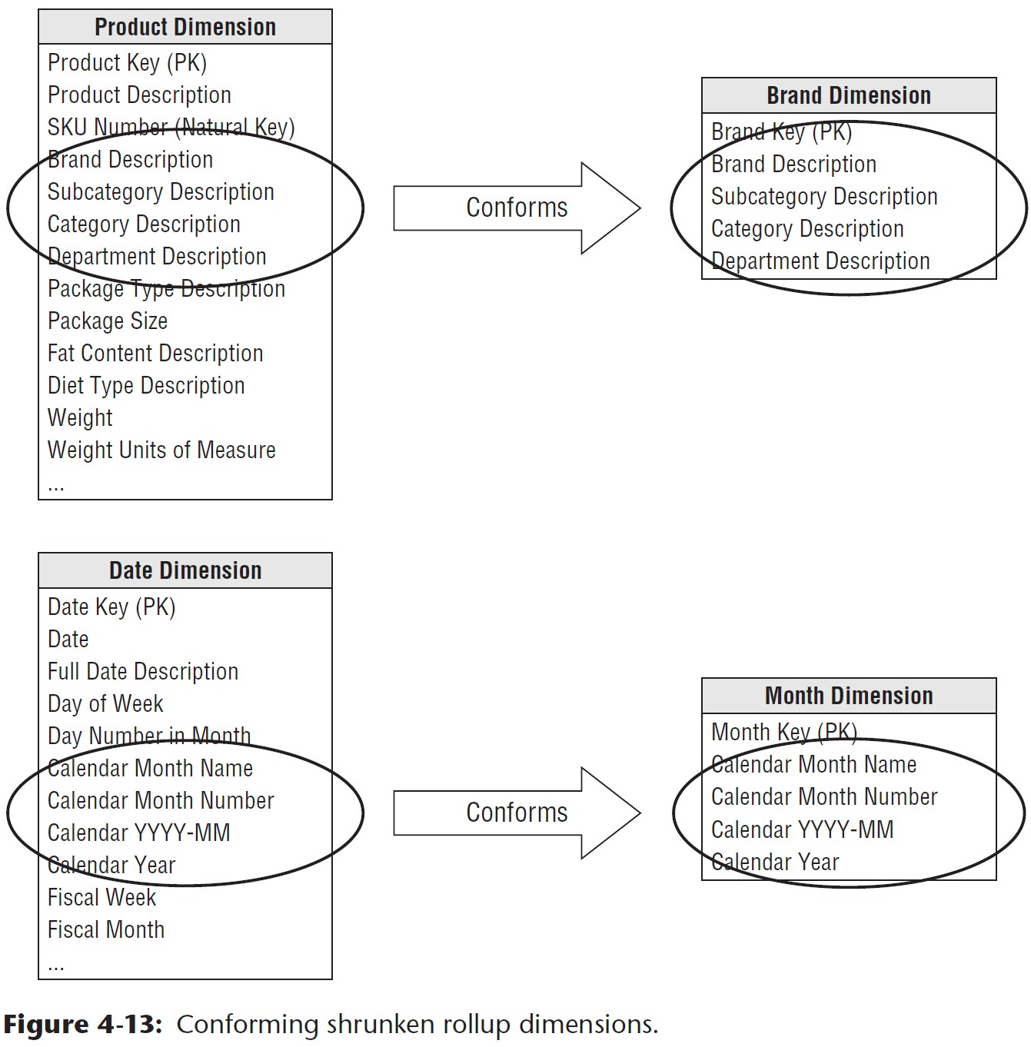
Shrunken rollup conformed dimensions with attribute subset

Slide 29
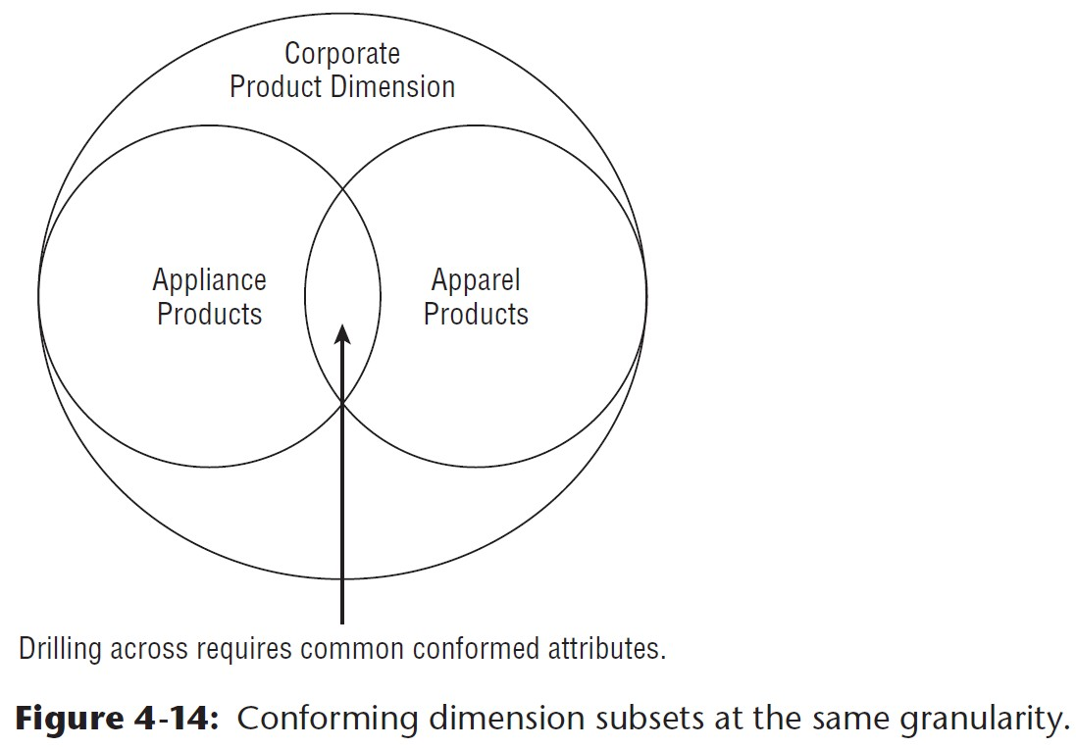
Conforming dimension subsets at the same granularity

Slide 30
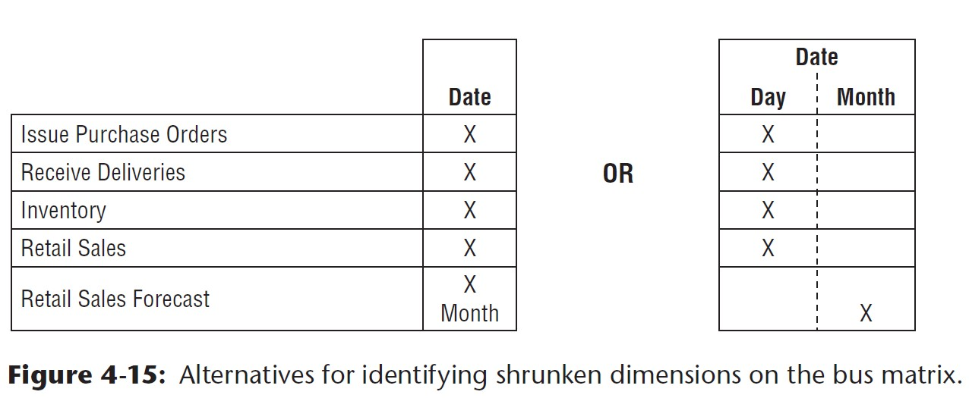
Shrunken conformed dimensions on the bus matrix

Slide 31
Importance of data governance and stewardship
Business-driven governance
spearheaded by strong leaders
Difficult to get people in different corners of the business to agree on: common attribute names, definitions, values, etc…
Shift away from compartementalized environment to one where information is shared and leveraged across the organization

Slide 32
Conformed dimensions in the agile age
Conformed dimensions allow a dimension table to be built and maintained once: quickly deliver new fact tables because associated dimension tables are ready.
Impossible to get full agreement on conformed dimensions
At least, identify a subset of attributes that have meaning across the enterprise.

Slide 33
Summary
Periodic snapshots for long-running, continuously replenished inventory scenarios
Accumulating snapshot for finite inventory pipeline situations with clear milestones
Each business process of value chain translates to a row in the bus matrix, and also, a dimensional model
Importance of enterprise bus architecture for building an integrated DW/BI system

